Slide 1
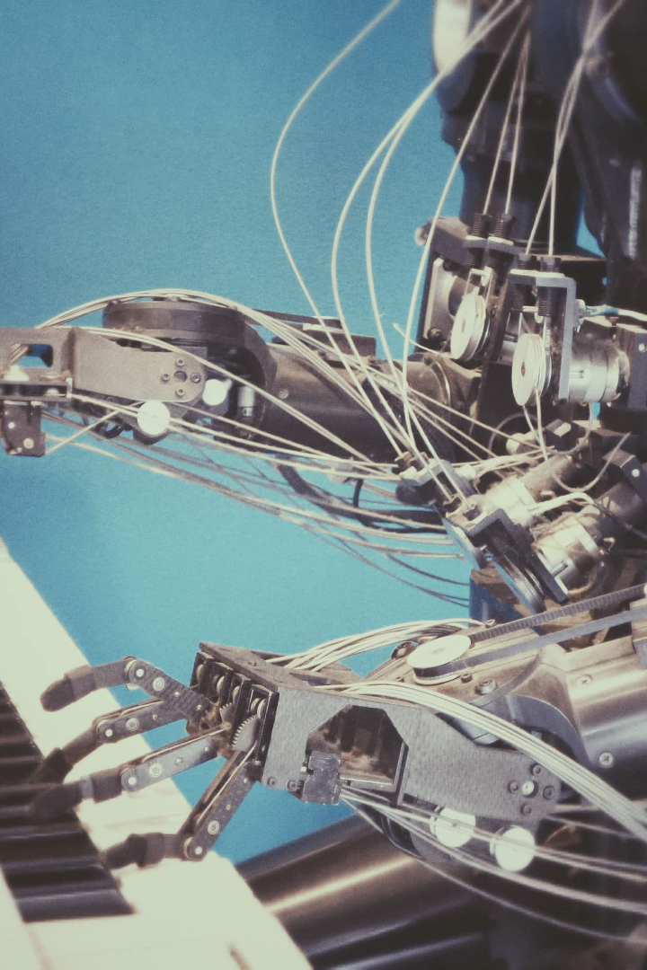
Types of Automation
Welcome to our presentation on types of automation. Automation is the future and we're here to enlighten you about its benefits, different types and limitations.
By -
Sufiya Sayyad
Onkar Dokhe
Sanika Menkudale

Slide 2
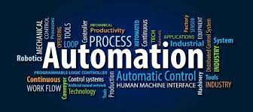
What Is Automation
Automation is the technology by which a process is accomplished without human assistance . It is implemented using a program of instruction combined with a control system that executes the instructions
Automation is the creation and application of technologies to produce and deliver goods and services with minimal human intervention. The implementation of automation technologies, techniques and processes improve the efficiency, reliability, and/or speed of many tasks that were previously performed by humans.

Slide 3
Continue….
Automation is a technology concerned with the application of mechanical, electronic and computer based system to operate and control production .
Its includes-
Automation machine tools to process parts.
Automation assembly machines.
Industrial robots.
Automatic material handling and storage systems.
Feedback control.

Slide 4
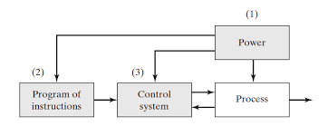
Elements of Automated System
Power to accomplish the process of operate the system
A program of instructions to direct the process
A control system to actuate the instructions

Slide 5

Reasons for Automation in manufacturing
Increased productivity
High cost of labour
Labour Shortage
Improved product quality
Reduced manufacturing lead time

Slide 6
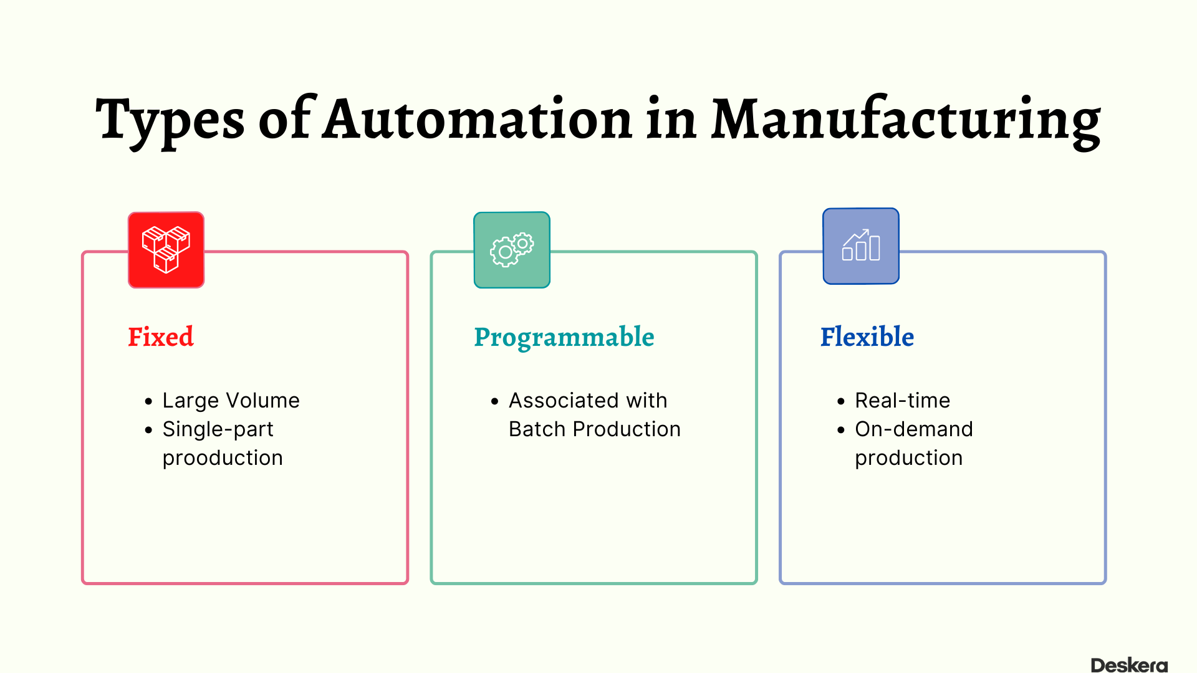

Slide 7
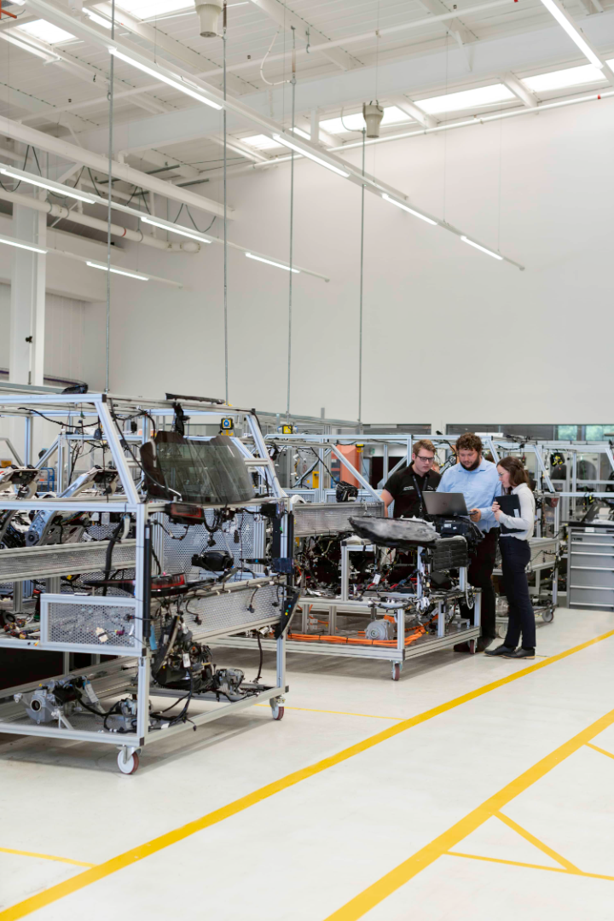

Benefits of Automation
1
Increased Efficiency
2
Higher Quality
Automation reduces the amount of time and resources required to complete a task, resulting in increased efficiency.
Automation helps eliminate errors and inconsistencies, leading to a higher quality and more reliable output.
3
Reduced Costs
4
Innovation
By automating certain processes, businesses can reduce labor costs and optimize the use of resources, leading to substantial cost savings.
Automation can free up resources and provide avenues for innovation, leading to new products and services that were not previously possible.

Slide 8
1.Fixed Automation
Definition
Examples
Fixed automation is when machines are designed to only perform a specific task or a set of tasks and cannot be easily reprogrammed or modified.
Assembly lines
Conveyor belts
Robotic welders

Slide 9
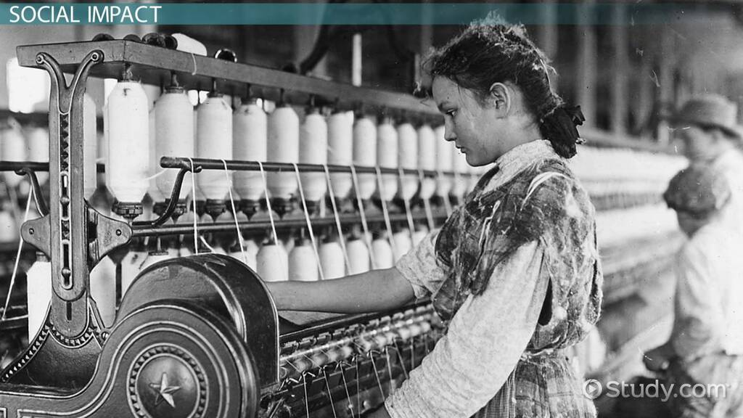
Historical development
Fixed automation has its roots in early industrialization. It began with the invention of specialized machinery for specific tasks during the First Industrial Revolution in the late 18th century. The development of mechanized looms for textiles, such as the Jacquard loom in the early 1800s, can be considered an early form of fixed automation.

Slide 10
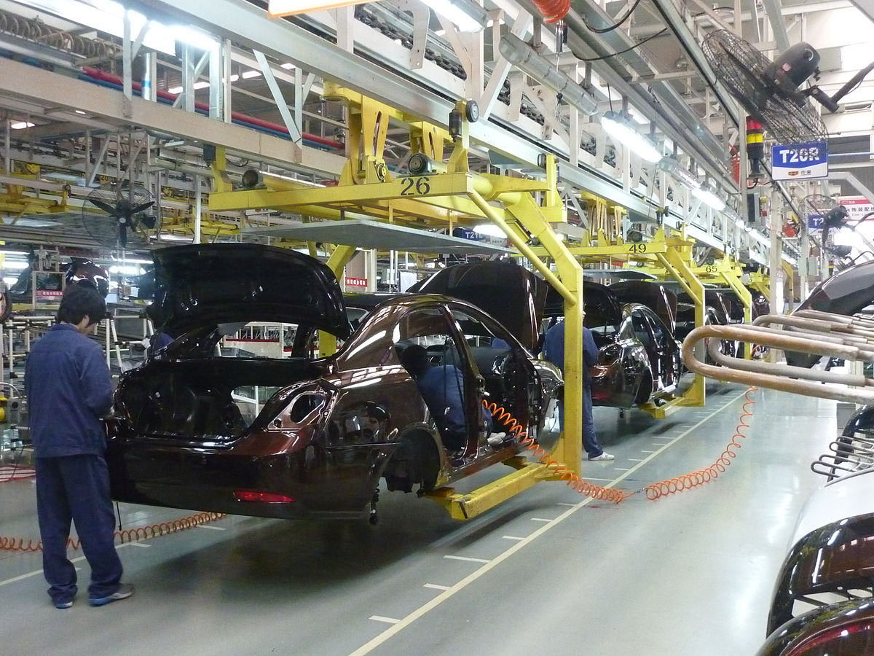
current usage
Today, fixed automation is still prevalent in industries like automotive manufacturing. In car assembly lines, robotic arms perform welding, painting, and assembly tasks precisely and repetitively. These systems are dedicated to specific functions, ensuring product consistency and high-speed production.
This Photo by Unknown Author is licensed under CC BY-SA

Slide 11
2.Programmable Automation
1
Definition
Programmable automation involves machines that can be programmed to perform a variety of tasks based on different inputs, and can be reprogrammed as needed.
Examples
2
CNC machines, 3D printers, robotic arms
3
Advantages
Flexibility
Higher precision
Ability to produce complex parts

Slide 12
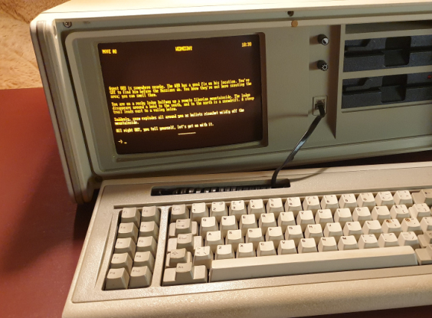
Historical development
The development of programmable automation can be traced back to the mid-20th century with the advent of digital computers. The first numerical control (NC) machines were introduced in the 1940s, which laid the foundation for programmable automation

Slide 13
current usage
Programmable automation has evolved and expanded into various industries, including aerospace, automotive, and electronics manufacturing. Modern CNC machines, controlled by computer programs, enable the precise and efficient production of complex components.

Slide 14
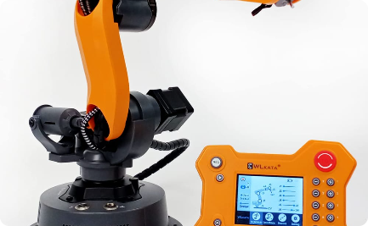
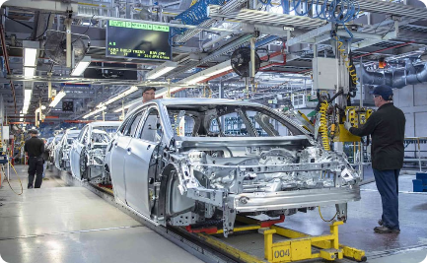
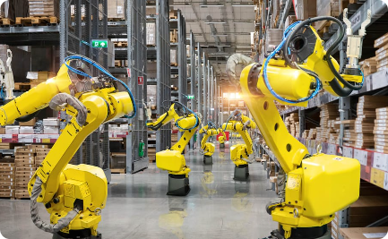
3.Flexible Automation
Definition
Examples
Advantages
Flexible automation systems are designed to handle a variety of products or tasks and can be easily reprogrammed to adapt to changing needs.
Automated manufacturing systems, material handling systems, packing systems
Adaptability to variable production volumes
Ability to produce a wide range of products

Slide 15
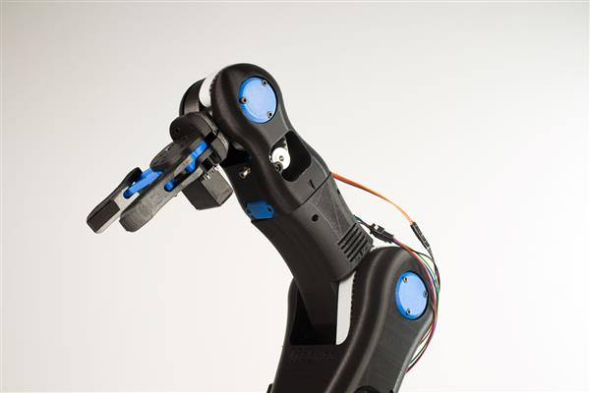
Historical development
Flexible automation developed alongside advancements in robotics and computer control systems during the late 20th century. The introduction of industrial robots and advanced control algorithms played a pivotal role in its development.

Slide 16
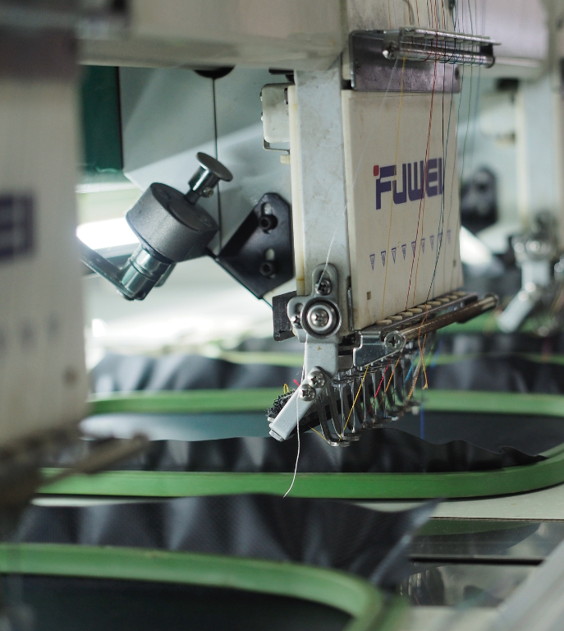
current usage
Today, flexible automation is widely used across various industries, including electronics, food processing, and clothing,shoes Industrial robots equipped with vision systems and adaptive grippers can handle diverse tasks and adapt to changes in production requirements, making them invaluable for high-mix, low-volume production scenario.

Slide 17
Examples of Automation
Amazon Go Stores
Tesla Factory
Automated stores that uses sensors to track items, eliminating the need for cashiers.
A highly automated factory using robotic automation to make electric cars
Self-Driving Cars
Smart Home Systems
They use various automation technologies like sensors, computer vision and machine learning to navigate on roads with little or no human intervention.
Automation technologies such as voice-activated virtual assistants, smart locks and smart thermostats are included in some home systems to simplify everyday tasks.

Slide 18
Challenges and Limitations of Automation
1
Technological Limitations
Not all tasks can be automated. Some require human reasoning and decision-making skills.
Costs
2
The initial cost of setting up automated systems can be high, especially for small businesses.
3
Social and Economic Impact
Automation can create job displacement and worsen income inequality if not managed efficiently.

Slide 19
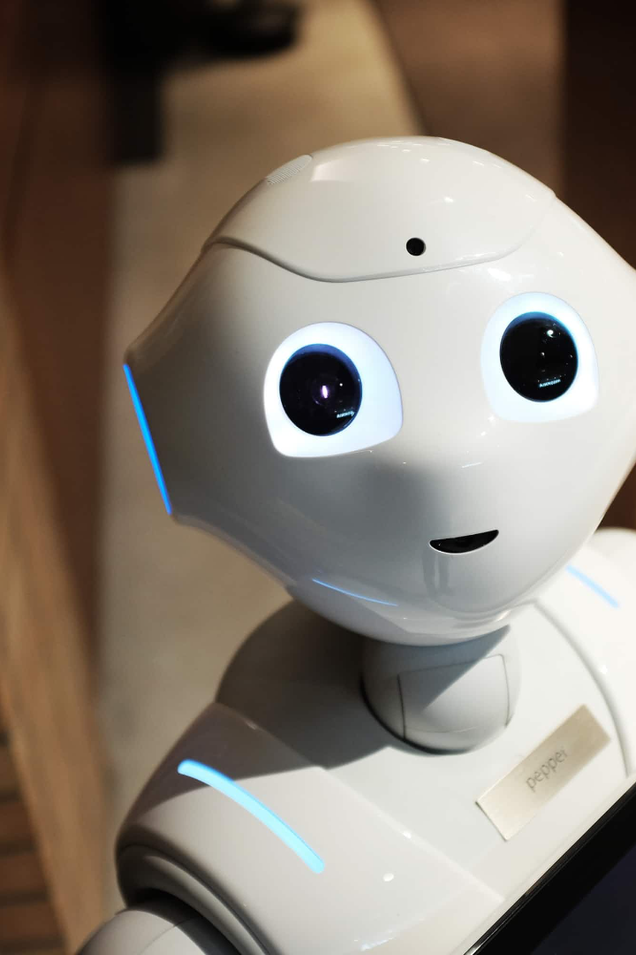
Conclusion
Automation is critical for businesses to stay competitive in today's fast-paced world. It offers numerous benefits such as increasing efficiency, higher quality, reduced costs and innovation. Fixed, Programmable and Flexible Automation are the major types of automation. They have transformed several sectors, including manufacturing, retail and transportation. However, there are still challenges such as technological limitations, economic impacts and costs that we need to address as we move towards an automated world.

